Slide 1


Slide 2
JOINS
JOINS are used to retrieve data from multiple tables. It is performed whenever two or more tables are joined in a SQL statement.
INNER JOIN (or sometimes called simple join)
LEFT OUTER JOIN (or sometimes called LEFT JOIN)
RIGHT OUTER JOIN (or sometimes called RIGHT JOIN)
FULL OUTER JOIN (or sometimes called FULL JOIN)
CROSS JOIN (or sometimes called CARTESIAN JOIN)
TYPES

Slide 3
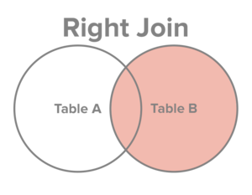
RIGHT JOIN
The RIGHT JOIN returns all rows from the right table, even if there are no matches in the left table.
SELECT table1.column1, table2.column2...
FROM table1
RIGHT JOIN table2
ON table1.common_field = table2.common_field;
Syntax

Slide 4
RIGHT JOIN
The RIGHT JOIN returns all rows from the right table, even if there are no matches in the left table.
SELECT
a.order_line ,
a.product_id,
a.customer_id,
a.sales,
b.customer_name,
b.age
FROM sales_2015 AS a
RIGHT JOIN customer_20_60 AS b
ON a.customer_id = b.customer_id
ORDER BY customer_id;
Example

